Slide 1


Carson Parfitt
July 2024

Slide 2

Outline
Executive Summary
Introduction
Methodology
Results
Conclusion
Appendix

Slide 3
Executive Summary
Methodologies
Data Collection
API
Web Scrapping
Data Wrangling
Exploratory Data Analysis
SQL
Data Visualization (Pandas Matplotlib)
Interactive Visual Analytics with Folium
Predictive Analysis
Results
Results of Predictive Analysis
Results of Exploratory Data Analysis
Interactive Data Visualization

Slide 4
Introduction
SPACE Y background and context
SpaceX advertises Falcon 9 rocket launches on its website with a cost of 62 million dollars; other providers cost upward of 165 million dollars each, much of the savings is because SpaceX can reuse the first stage. Therefore if we can determine if the first stage will land, we can determine the cost of a launch. This information can be used if an alternate company wants to bid against SpaceX for a rocket launch. This projects goal is understand if SPACE Y can accurately predict if the first stage of the rocket launch will land successfully.
Problems you want to find answers
What will cause the rocket to land successfully?
How successful will the landing be?
What conditions need to exist for a successful launch?
What is the cost of a Launch?

Slide 5

Section 1

Slide 6
Methodology
Executive Summary
Data collection methodology:
The data was collected from SpaceX API and web scraping from Wikipedia Pages
Perform data wrangling
Data was collected and converted into Pandas data frame for visualization and analysis
Perform exploratory data analysis (EDA) using visualization and SQL
Perform interactive visual analytics using Folium and Plotly Dash
Perform predictive analysis using classification models
Using machine learning to address if the first stage of Falcon 9 landing will be successful.

Slide 7
Data Collection
SpaceX REST API
Get request for SpaceX data using requests library
Receive data as .JSON file
Convert .JSON into Pandas data frame
Clean and check data
The data was collected from SpaceX REST API and web scrapped from Wikipedia
Web Scraping Falcon 9 launch records
Use Beautiful Soup to web scrape HTML tables
Extract HTML table
Parse data from tables
Convert table into pandas data frame

Slide 8
Data Collection – SpaceX API
Here the data was collected, cleaned and formatted
Collection API notebook
SpaceX REST API
Get request for SpaceX data using requests library
Extract info about:
Booster name
Launch site
Payload mass
Landing site
Get historical launch data as .JSON
Convert .JSON into pandas data frame
Filter data frame to only include Falcon 9 launches
Address missing values
Complete data wrangling

Slide 9
Data Collection - Scraping
Applied web scraping to collect Falcon 9 launch records from Wikipedia Pages
Web Scraping Notebook
Request Falcon 9 launch Wiki page from URL
Use BeautifulSoup on request response
Extract all names from HTMl header
Create data frame by parsing launch HTML tables
Complete data wrangling

Slide 10
Data Wrangling
Preformed Exploratory Data Analysis (EDA) to determine the labels needed to train dataset and to find patterns
Data Wrangling Notebook
Find missing values
Identify which columns are categorical and which are numerical
Calculate the number of launches for each site
Calculate occurrence and number of each of the orbits
Calculate number/ occurrence of the mission outcome per orbit
Create a label “Landing Outcome” from outcome column

Slide 11
EDA with Data Visualization
What charts were plotted and why
Most of the charts plotted are Catplot(scatter plot) to help visualize the relationship between a numerical value and a categorical value
Flight number and Payload
Flight number and Launch
Payload and Launch Site
Flight Number and Orbit Type
Payload and Orbit type
One chart plotted was a Bar chart used to show a distribution of data/compare values
Success rate and Orbit type
One chart plotted was a Line chart used to track changes over time
Launch success yearly trend
EDA with Data Visualization Notebook

Slide 12
EDA with SQL
EDA was applied with SQL to help obtain information about the data.
Launch sites starting with “CCA” were pulled out
Total payload mass carried by boosters/boosters F9 v1.1were determined
Successful landing(ground pad)/(drone ship) outcomes determined
Total number of success and failures of missions
The failed landing outcomes in drone ship, their booster version and launch site names
EDA with SQL Notebeook

Slide 13
Build an Interactive Map with Folium
All launch sites were marked and map objects (markers, circles, and lines) were added to the map to mark the success or failures of each launch. Additional features were added to help address questions as well.
A highlighted circle area with a text label on a specific coordinate for each launch site on the site map was added
Cluster objects were added to simplify the map that had many markers having the same coordinate
Mouse position was added to have a pointer show up when hovering over the map
Line were drawn between each launch site and its closest city, railway and highway.
Launch Sites Locations with Folium Map

Slide 14
Build a Dashboard with Plotly Dash
This dashboard was created to preform interactive analysis of SpaceX launch data in real time.
This dashboard contains various inputs
Launch site drop down
Callback function – this renders a success pie chart based on the selected site drop down.
A range slider used to select payload
Interactive Plotly Dashboard

Slide 15
Predictive Analysis (Classification)
Through the machine learning process the best hyperparameters for logistic regression, SVM, Decision Trees and KNN classifiers were able to be determined
Machine Learning Prediction Notebook
Load the data
Use data set part 2 to create variable Y from the column “Class”
Standardize data in X and reassign to X using Transform
Train/test split to split data into training and testing
Creation of logistic regression, SVM, Decision Tree KNN and GridSearchCV objects
Best parameters, accuracy and confusion matrix
Select method that has best performance

Slide 16
Results
Exploratory data analysis results
Interactive analytics demo in screenshots
Predictive analysis results

Slide 17

Section 2

Slide 18
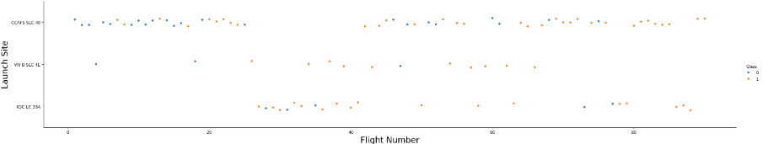
Flight Number vs. Launch Site
Over time the success of the launch rates have increased at every launch site. Most notably at CCAFS SLC-40 where most launches take place
VAFB and KSC represent 1/3 of the total launches

Slide 19
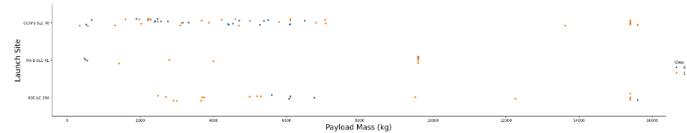
Payload vs. Launch Site
VAFB does not launch rockets with a heavy payload mass (greater than 10000 kg)
KSC does not launch rockets with a lower payload mass (less than 2500 kg)
CCAFS has launched rockets less than 7500kg and more than 13000kg but does not launch rockets in-between that range

Slide 20
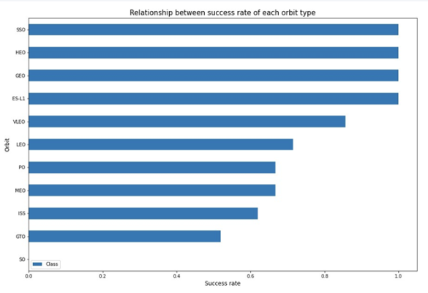
Success Rate vs. Orbit Type
The first four (SSO, HEO, GEO, ES-L1) have the best success rate

Slide 21
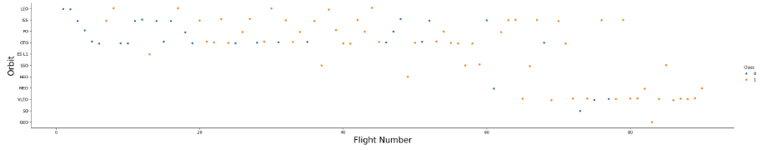
Flight Number vs. Orbit Type
There are more failures at the beginning of launch series but as more progress the ratio improvs by the number of unsuccessful landings reducing
GTO and ISS orbits have the highest concentration of launches with the lowest ratio of successful landings
The orbits with a higher success rate have an overall fewer launches made

Slide 22
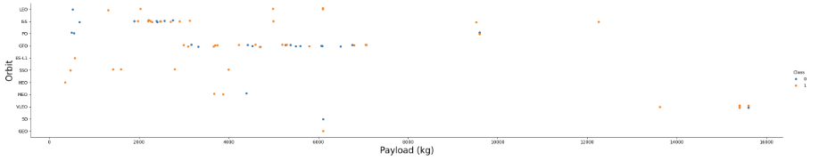
Payload vs. Orbit Type
For heavy payloads PO, LEO and ISS have a higher landing success rate
GTO has both positive and negative landing rates making it hard to determine overall success rate

Slide 23
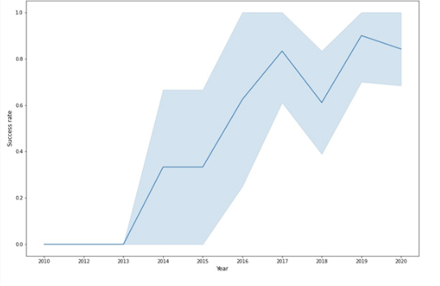
Launch Success Yearly Trend
The success rate continued to increase from 2013 - 2020

Slide 24
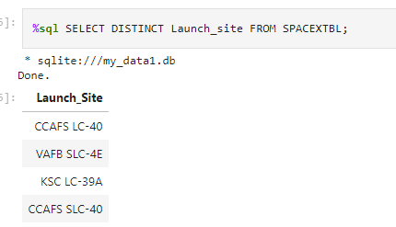
All Launch Site Names
There are Four unique launch sites
“DISTINCT” in SQL finds all unique values – in this case it was used in the launch column to pull the unique names.

Slide 25
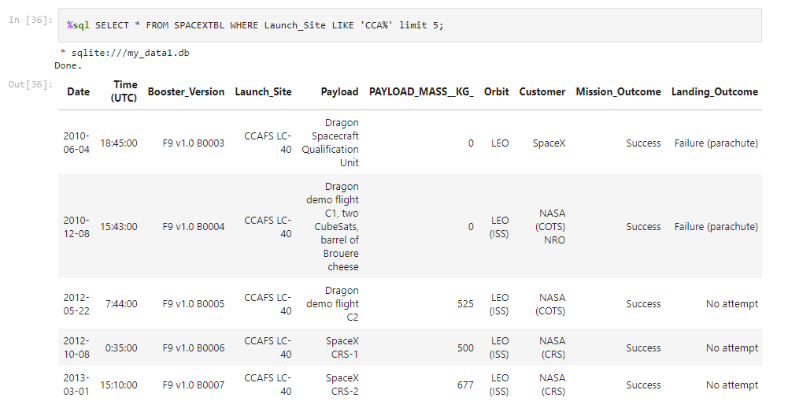
Launch Site Names Begin with 'CCA'
The query used WHERE LIKE LIMIT to find 5 records where launch sites begin with
“CCA”

Slide 26
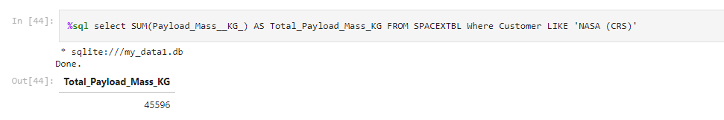
Total Payload Mass
Using SUM an d WHERE the total payload mass carried y booster launched by NASA was calculated

Slide 27
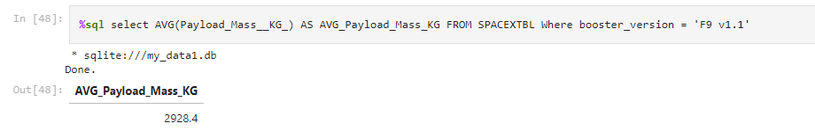
Average Payload Mass by F9 v1.1
Using AVG() function the average payload mass carried by booster version F9 v1.1 was calculated

Slide 28
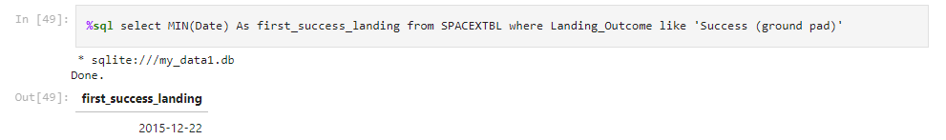
First Successful Ground Landing Date
This is the data from the first successful ground pad landing outcome. This was achieved using MIN

Slide 29
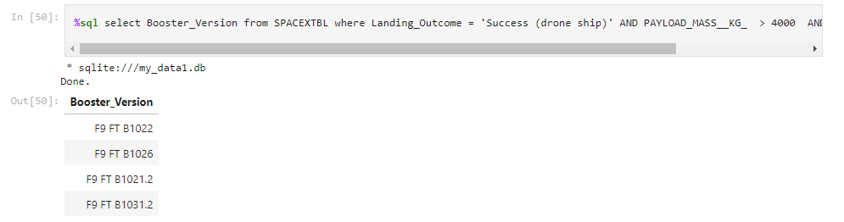
Successful Drone Ship Landing with Payload between 4000 and 6000
Boosters which have successfully landed on drone ship and had payload mass greater than 4000 but less than 6000. This is found using WHERE and AND clause together

Slide 30
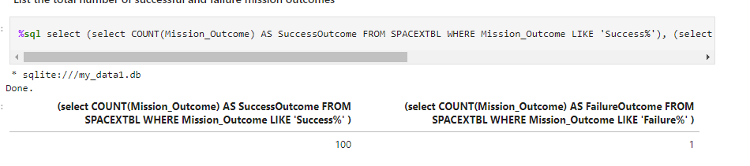
Total Number of Successful and Failure Mission Outcomes
The total number of successful and failure mission outcomes. This uses COUNT with GROUP BY

Slide 31
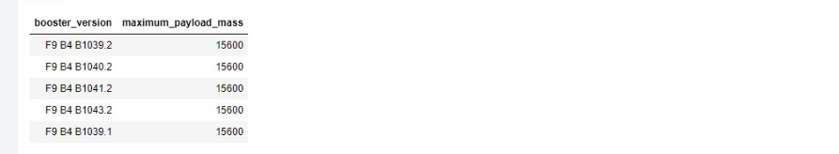
Boosters Carried Maximum Payload
These are the names of the booster versions which have carried the max payload mass, this was found using subquery

Slide 32
2015 Launch Records
Failed landing_outcomes in drone ship, their booster versions, and launch site names for in year 2015

Slide 33
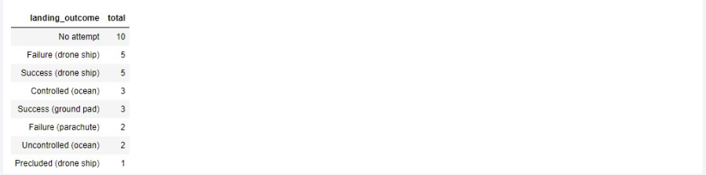
Rank Landing Outcomes Between 2010-06-04 and 2017-03-20
Thecount of landing outcomes (such as Failure (drone ship) or Success (ground pad)) between the date 2010-06-04 and 2017-03-20, in descending order. Query uses CPUNT, WHERE, BETWEEN and GROUP BY

Slide 34

Section 3

Slide 35
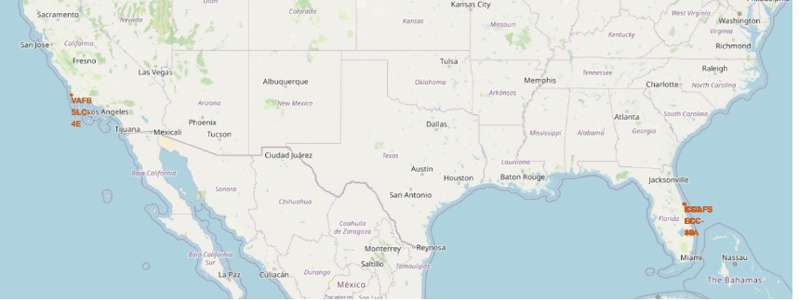
All Launch Sites
Launch sites are close to the coast and within the US California and Florida

Slide 36
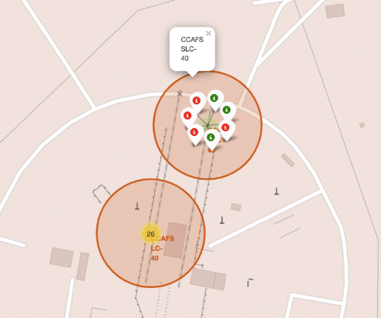
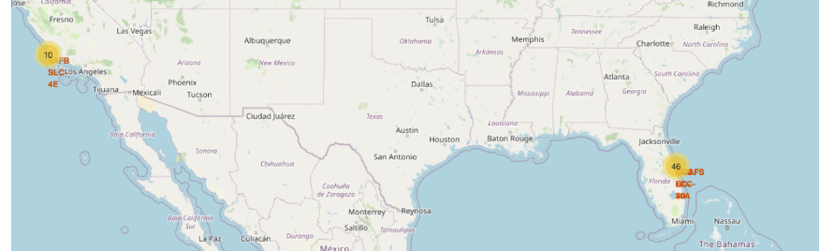
Success/Failed Launches per site
The first map shows clusters for each launch site. The second map shows green markers if the launch was successful and red markers if it was not

Slide 37
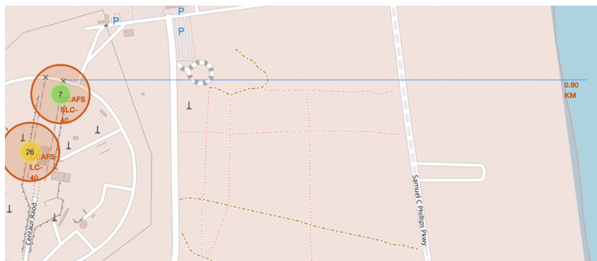
Proximities to Launch Site
This shows how close the launch sites are to railways, roads, coastlines, etc.

Slide 38

Section 4

Slide 39
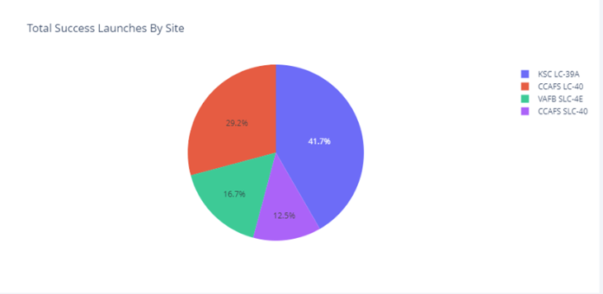
Total Success Launches by Site
KSC has the highest successful launches followed by CCAFS

Slide 40
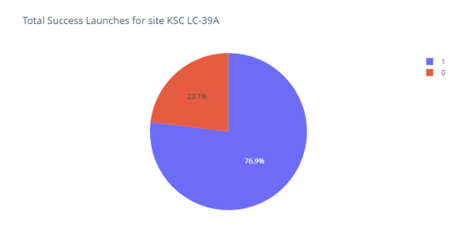
Highest Launch Success Ratio
This pie chart sows KSC as the site which the highest launch success ratio

Slide 41
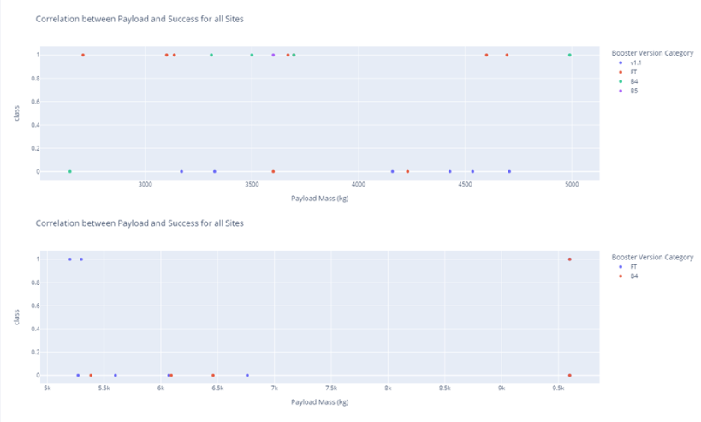
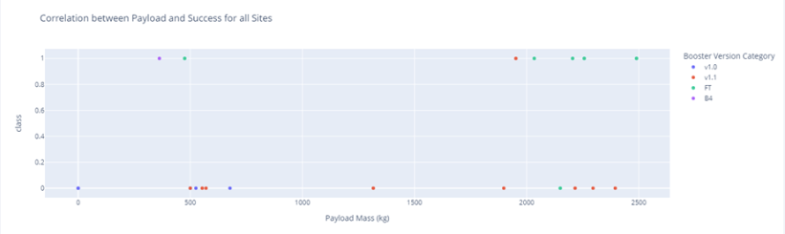
Payload VS Launch Outcome
Scatter plot for all sites (2500kg, 5000kg and 10000kg) payload ranges
Payload range 2500-5000kg have most of the successful launches

Slide 42

Section 5

Slide 43
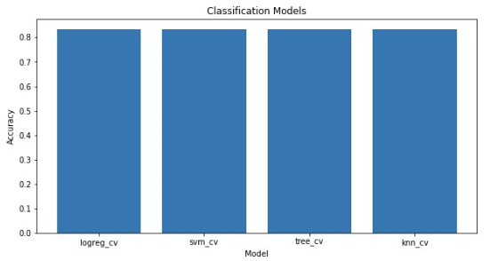
Classification Accuracy
Accuracy is the same for all models

Slide 44
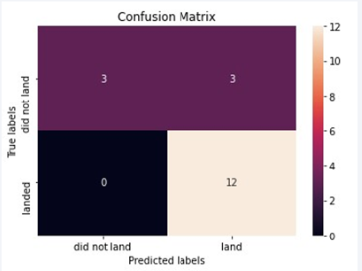
Confusion Matrix
Confusion Matrix same for all models

Slide 45
Conclusions
In conclusion:
The more flights that take place at a launch location the higher the chances of are of a successful launch
Successful launches increased from 2013-2020
KSC LC-39A had the most successful launches of any site
All machine learning models seem to have the same amount of accuracy

Slide 46
Appendix
For additional information/ raw files of the above please go to this GitHub Repository

Slide 47


